Slide 1
Xamarin forms 3.0-1-2-3 features and samples
ERHAN BALLIEKER
MCT

Slide 2
XAMARIN FORMS 3.0 FEATURES
Visual State Manager
FlexLayout
StyleSheets
Right-To-Left Localization

Slide 3
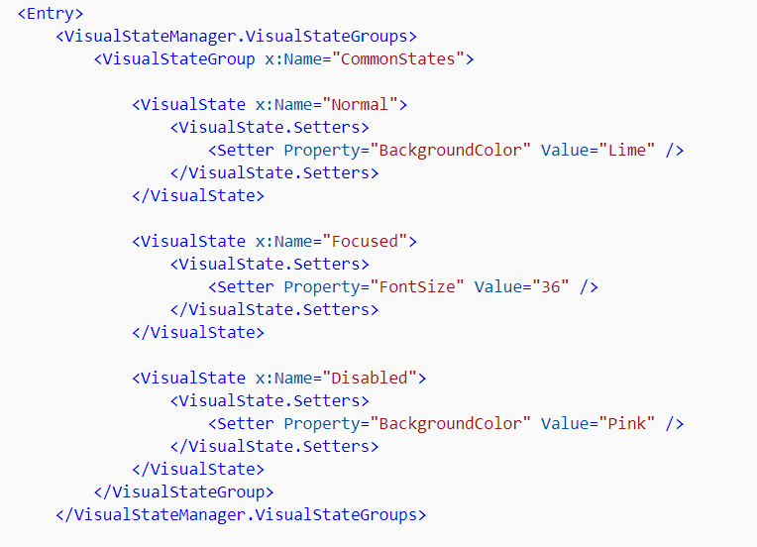

Slide 4
Right-to-left
XAML : FlowDirection="{x:Static Device.FlowDirection}“
Android : add android:supportsRtl="true" to your application tag in your AndroidManifest.xml, and make sure your MinSDKVersion is 17+.
iOS :
2 3 4 5 6 7 | <key>CFBundleDevelopmentRegion</key> <string>en</string> <key>CFBundleLocalizations</key> <array> <string>en</string> <string>ar</string> </array>

Slide 5
Stylesheet
The CSS file will fail to load if its build action is not set to EmbeddedResource.
navigationpage { -xf-bar-background-color: lightgray; } ^contentpage { background-color: lightgray; } #listView { background-color: lightgray; } stacklayout image{ margin: 20; }
https://docs.microsoft.com/en-us/xamarin/xamarin-forms/user-interface/styles/css/

Slide 6
XAMARIN FORMS 3.1 FEATURES
Android Bottom Tabs
Hide ScrollView scroll bars
Bindable Span
Autoresizable Editor
Add SelectionMode property to ListView
https://developer.xamarin.com/releases/xamarin-forms/xamarin-forms-3.1/3.1.0/

Slide 7
XAMARIN FORMS 3.2 FEATURES
SwipeGestureRecognizer
Rounded corners on BoxView
Padding on Buttons
Page TitleView
https://developer.xamarin.com/releases/xamarin-forms/xamarin-forms-3.2/3.2.0/

Slide 8
XAMARIN FORMS 3.3 FEATURES
MaxLines on Label
Label with Wrap/LineNumber and Truncation
Label underline/strikethrough support
Use WKWebView on iOS
https://developer.xamarin.com/releases/xamarin-forms/xamarin-forms-3.3/3.3.0/

